Slide 1


Slide 2
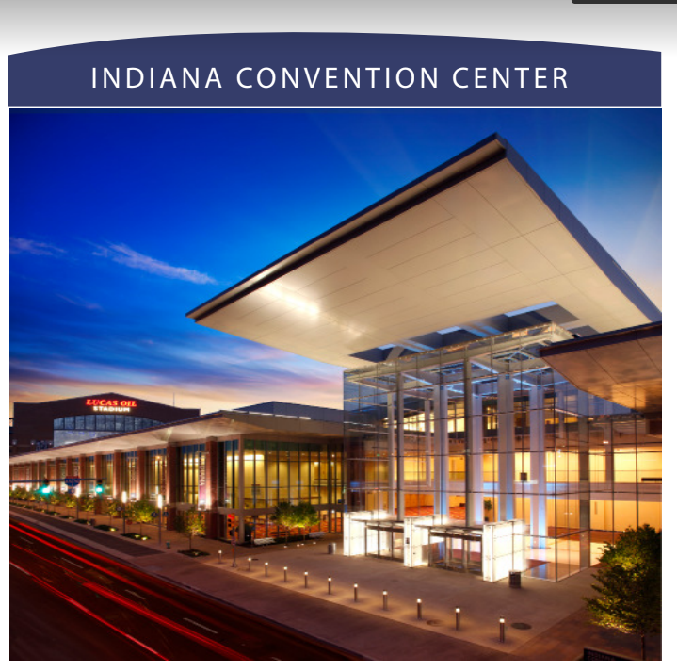


Slide 3
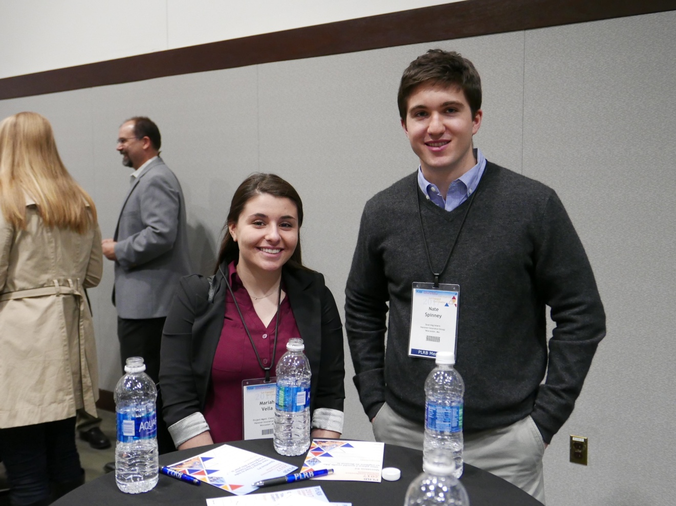
Orientation
for First-Time Attendees
Sunday
4:00 p.m. – 5:00 p.m.
Room 120, ICC

Slide 4
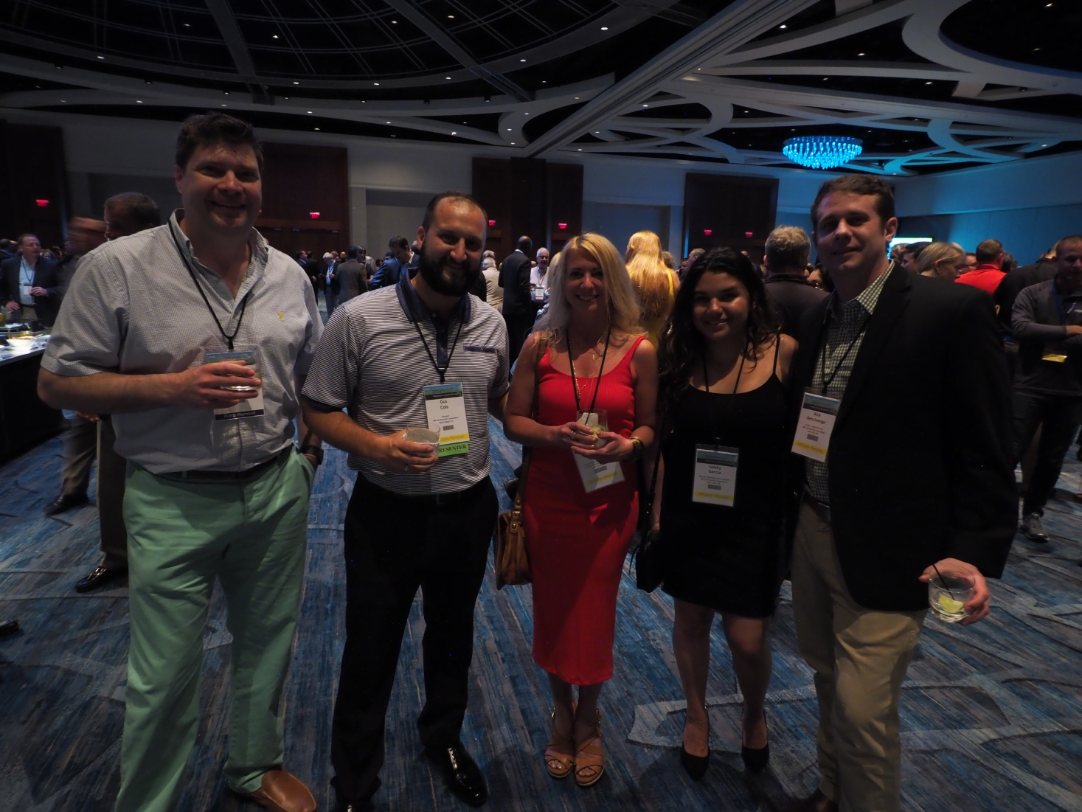
Welcome Reception
Sunday
5:30 p.m. – 7:00 p.m.
White River Ballroom, JW Marriott
Proper name badge required for admission.

Slide 5

PLRB Expo Passport
Pick up your passport at the Reg Desk.
Visit at least 20 expo booths and collect signatures in your passport for free PLRB swag.

Slide 6
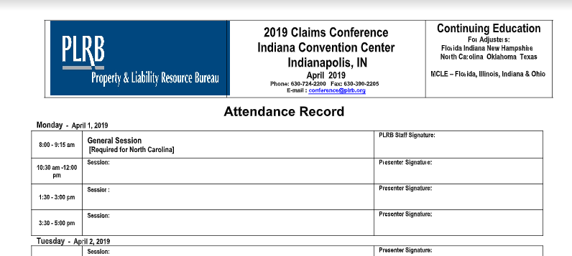
Continuing Education
The Claims Conference is approved for CE credit for adjusters licensed in Florida, New Hampshire, North Carolina, Oklahoma, and Texas!
Please complete attendance record and obtain presenters’ signatures for sessions you attend.

Slide 7
Continuing Legal Education (MCLE)
Approved for attorneys licensed in:
Florida
Illinois
Indiana
Ohio
Please complete attendance record and obtain presenters’ signatures for sessions you attend.

Slide 8
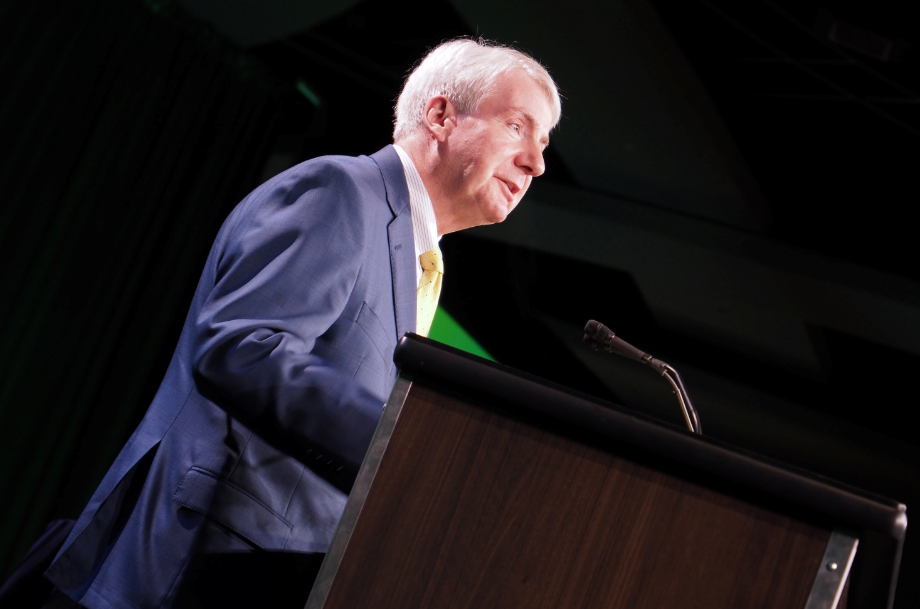

Welcome to the Claims Conference Monday at 8:00 a.m. Sagamore Ballroom
Thomas Mallin PLRB President & CEO

Slide 9
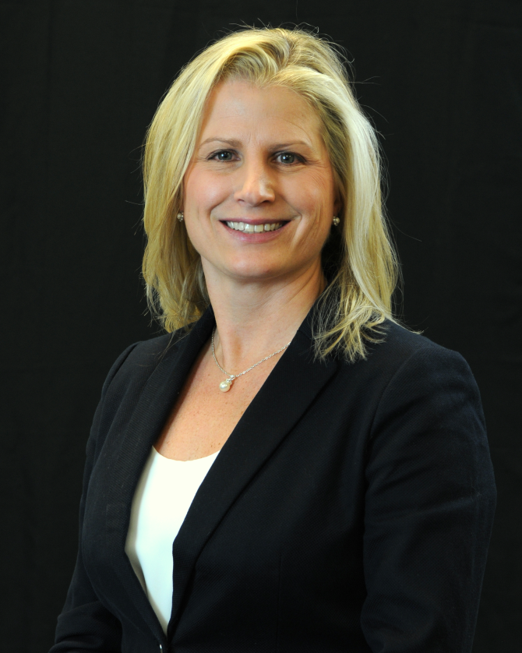
Conference Chair Welcome Monday at 8:00 a.m. Sagamore Ballroom
Betsy Marotta, CPCU, AIC
American National
P&C Group

Slide 10
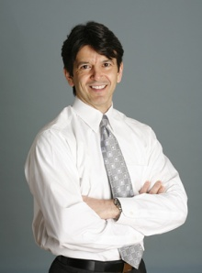
Keynote Address Monday, 8:00 a.m. – 9:15 a.m. Sagamore Ballroom
Shaping the Future of Work Through Talent Development
Tony Bingham
President and CEO,
Association for Talent Development (ATD)

Slide 11
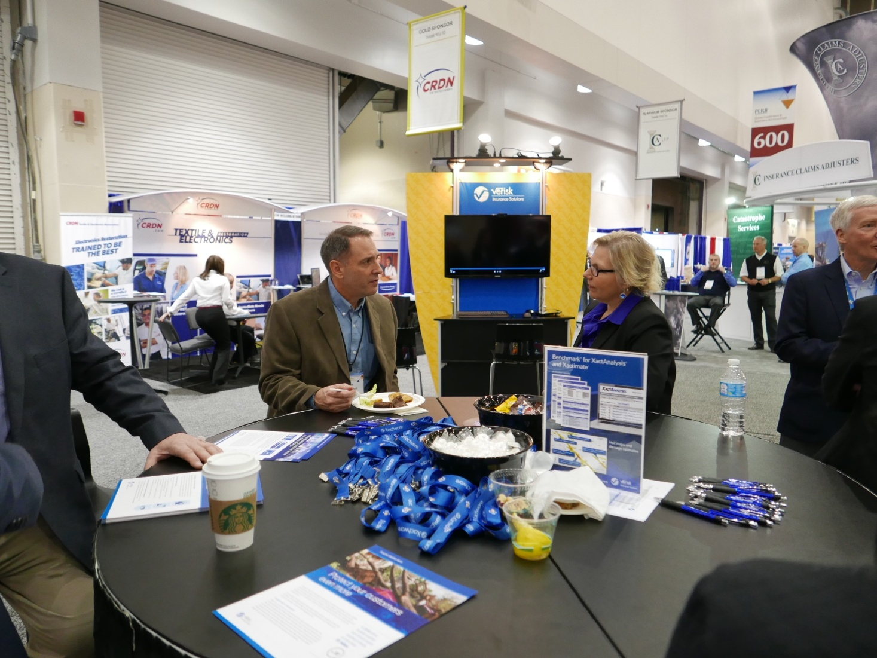
Insurance Services Expo Monday 9:30 a.m. – 5:00 p.m. Halls ABC

Slide 12
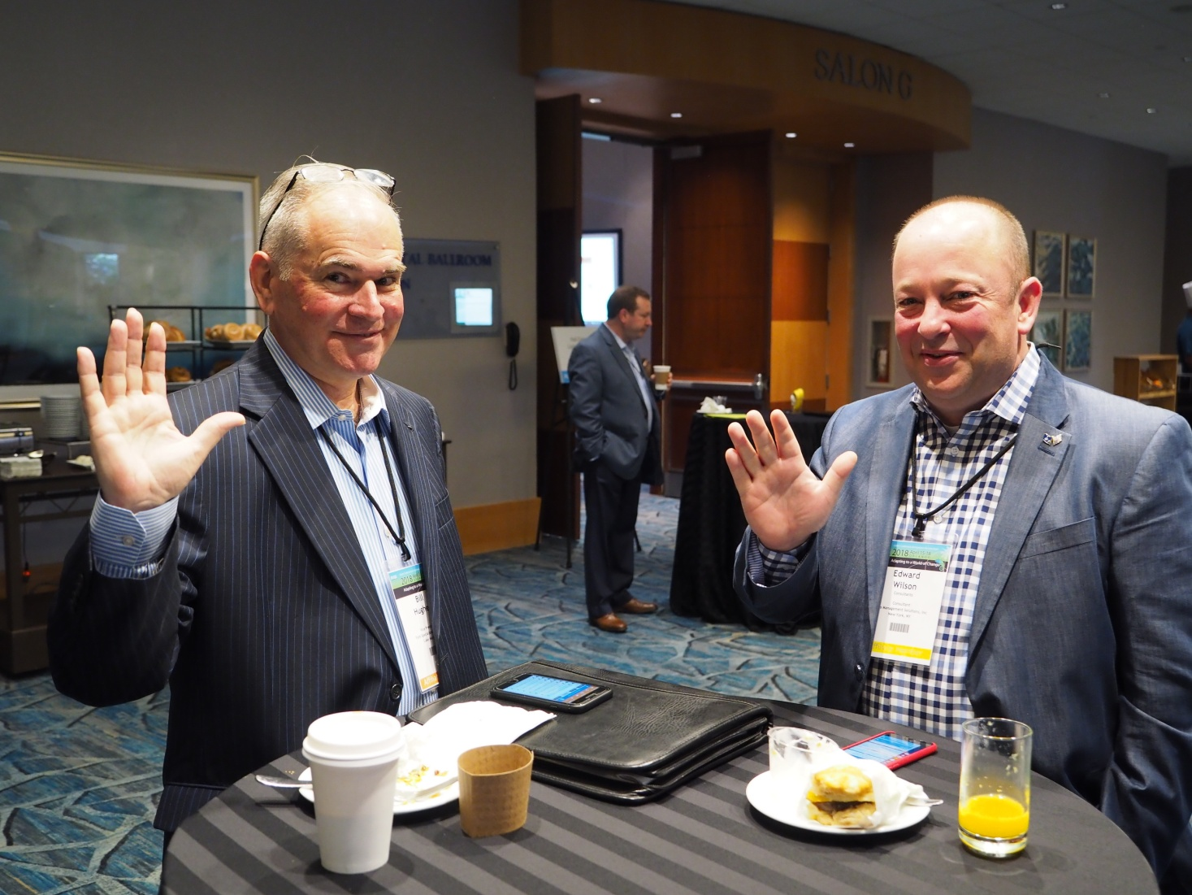
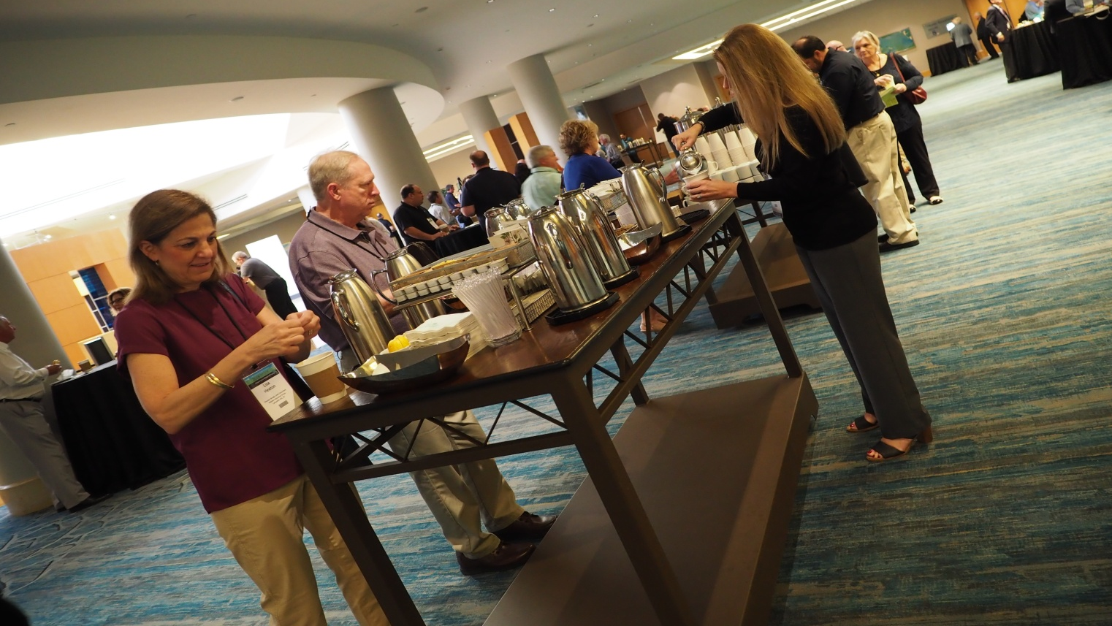
Continental breakfasts in Sagamore Ballroom

Slide 13






#PLRB #ClaimsConference2019 #LearningHasNoFinishLine
@PLRBconf
@plrb.plrb
@PLRB.org

Slide 14
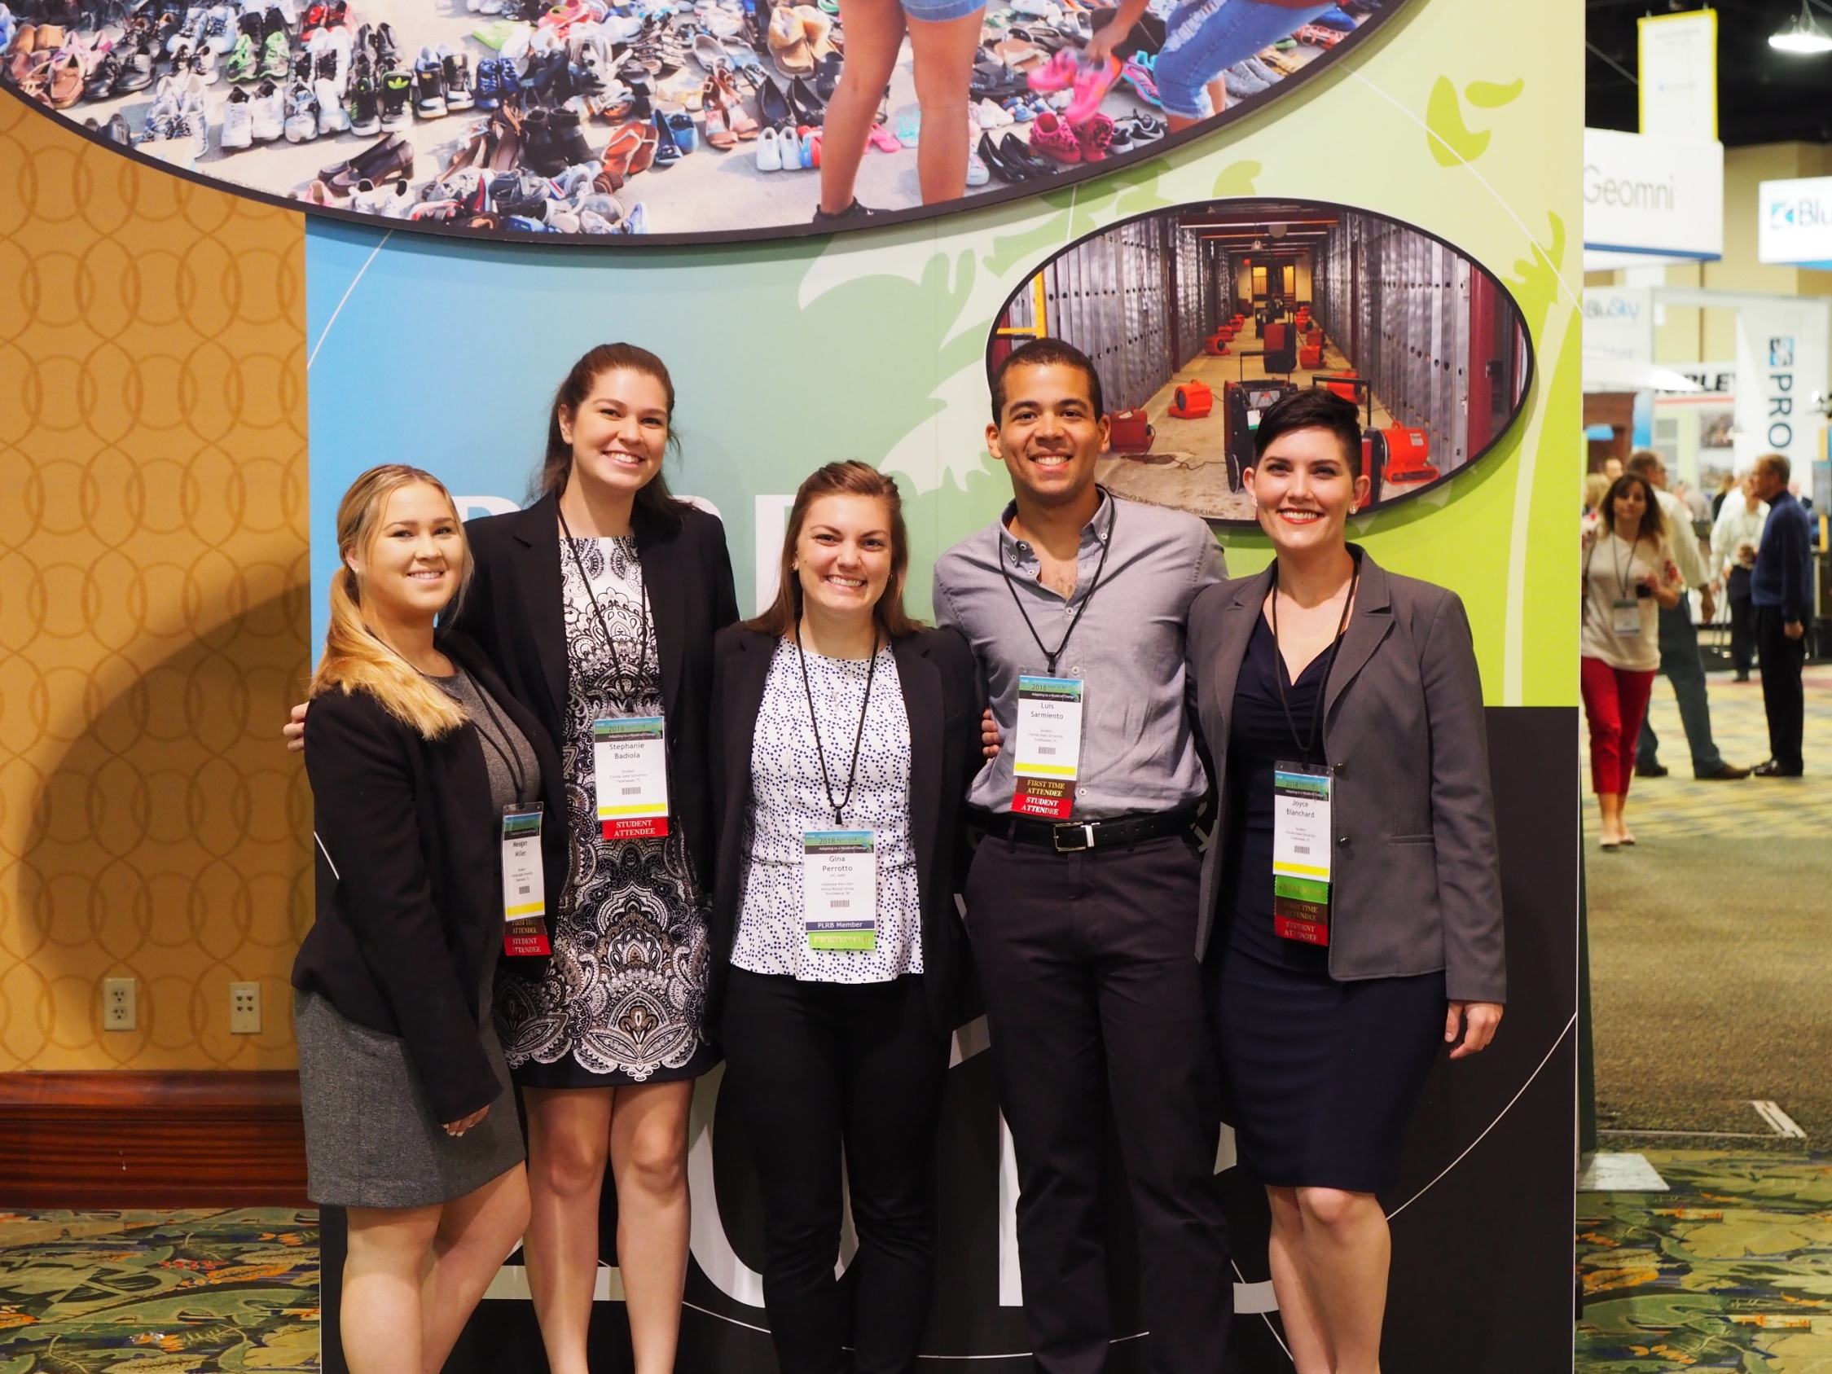

Slide 15
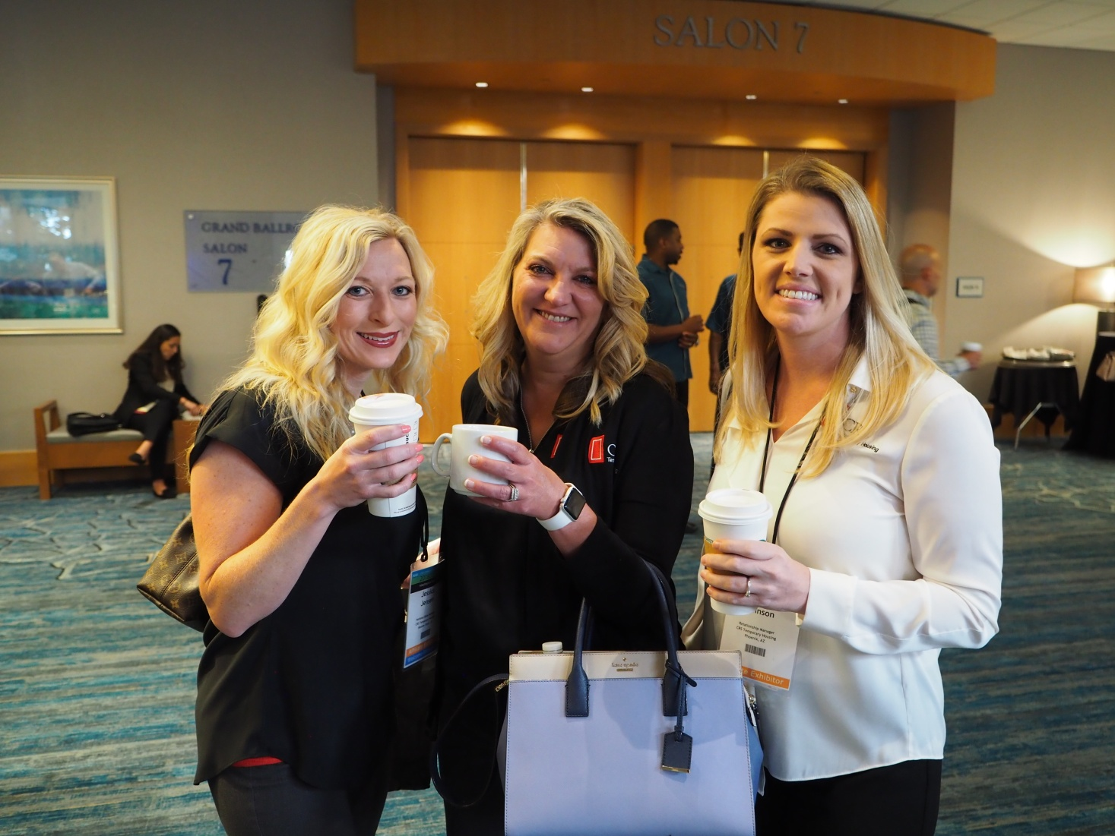
What is the dress code?
The dress code is business casual for all events.

Slide 16
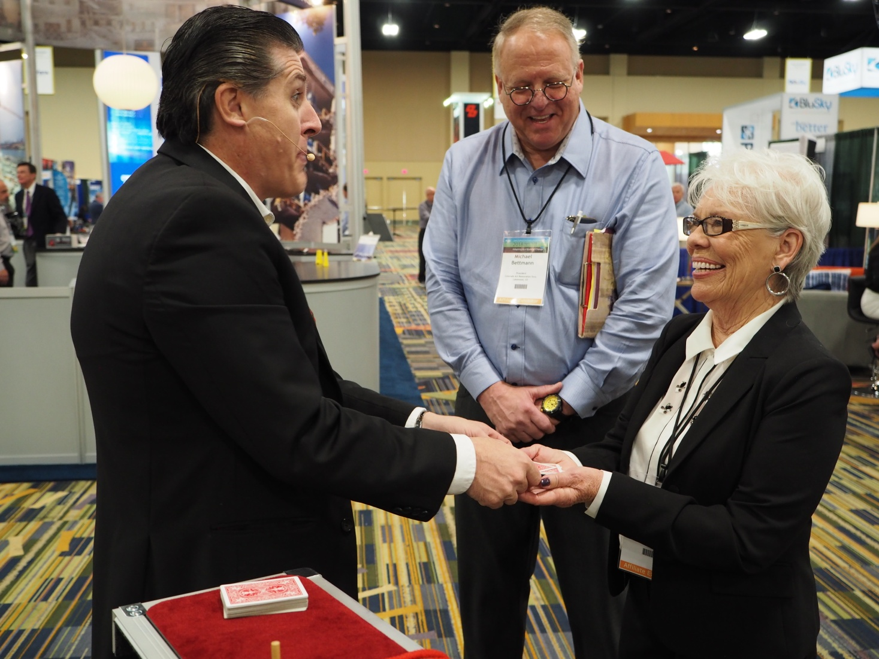
Insurance Services Expo Tuesday 9:30 a.m. – 5:00 p.m. Halls ABC

Slide 17
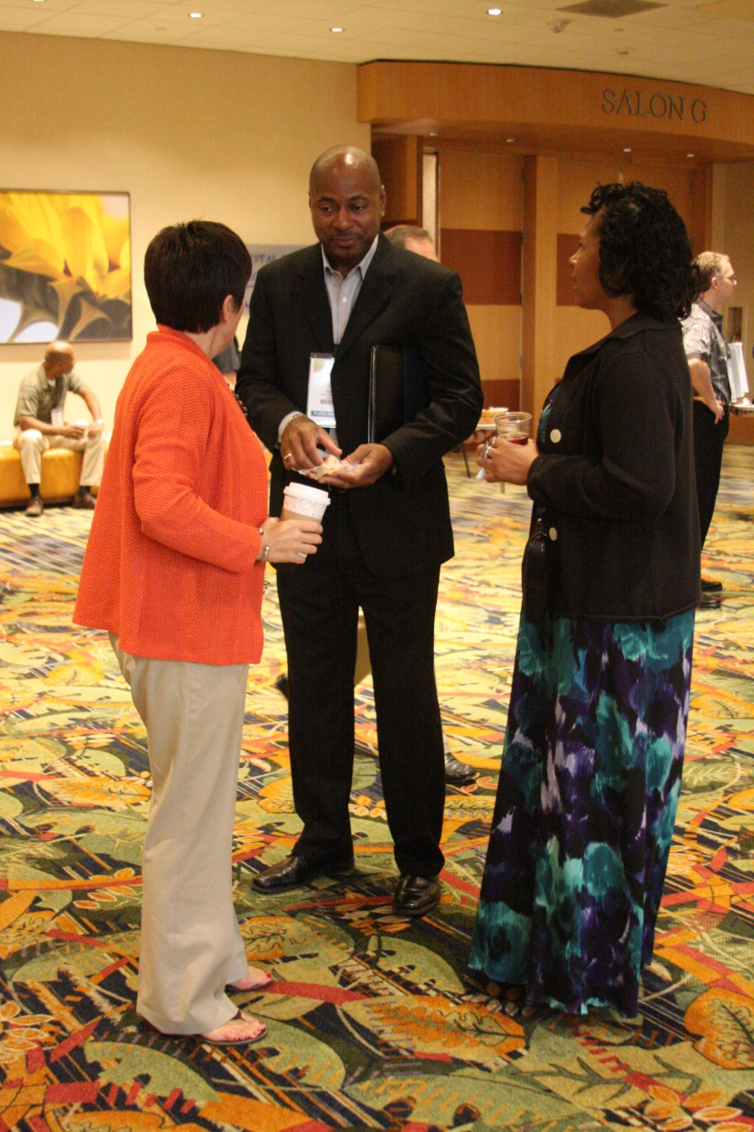
What is the dress code?
Business casual for all events

Slide 18

Monday 10:30 a.m. – 5:15 p.m. Tuesday 8:30 a.m. – 4:30 p.m. Room 117, ICC

Slide 19
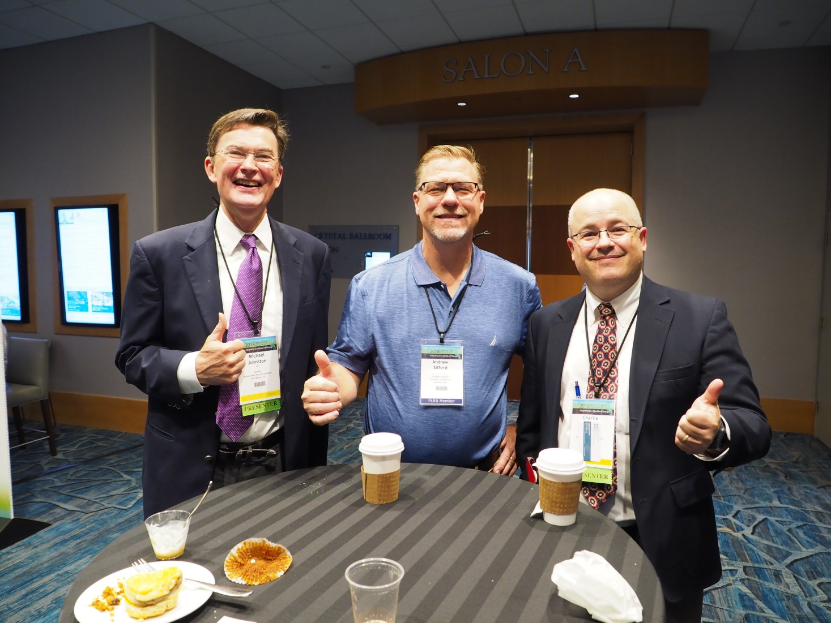
What is the dress code?
The dress code is business casual for all events.

Slide 20
What Comes With My Conference Registration?
Admission to all educational sessions and related materials
Welcome and Closing Receptions
Insurance Services Expo
Three continental breakfasts and refreshment breaks
Two complimentary lunches with exhibitors
Complimentary lunch with presentation on Wednesday

Slide 21

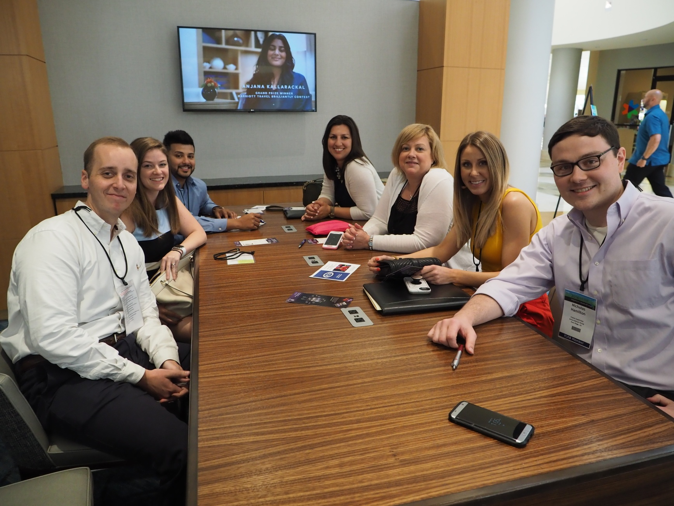
Learning Has No Finish Line

Slide 22
Do I need to wear my Claims Conference badge?
Yes!
Your name badge identifies you as a PLRB Claims Conference participant.
Lost name badges can be replaced at the Conference Registration / Information Desk.

Slide 23
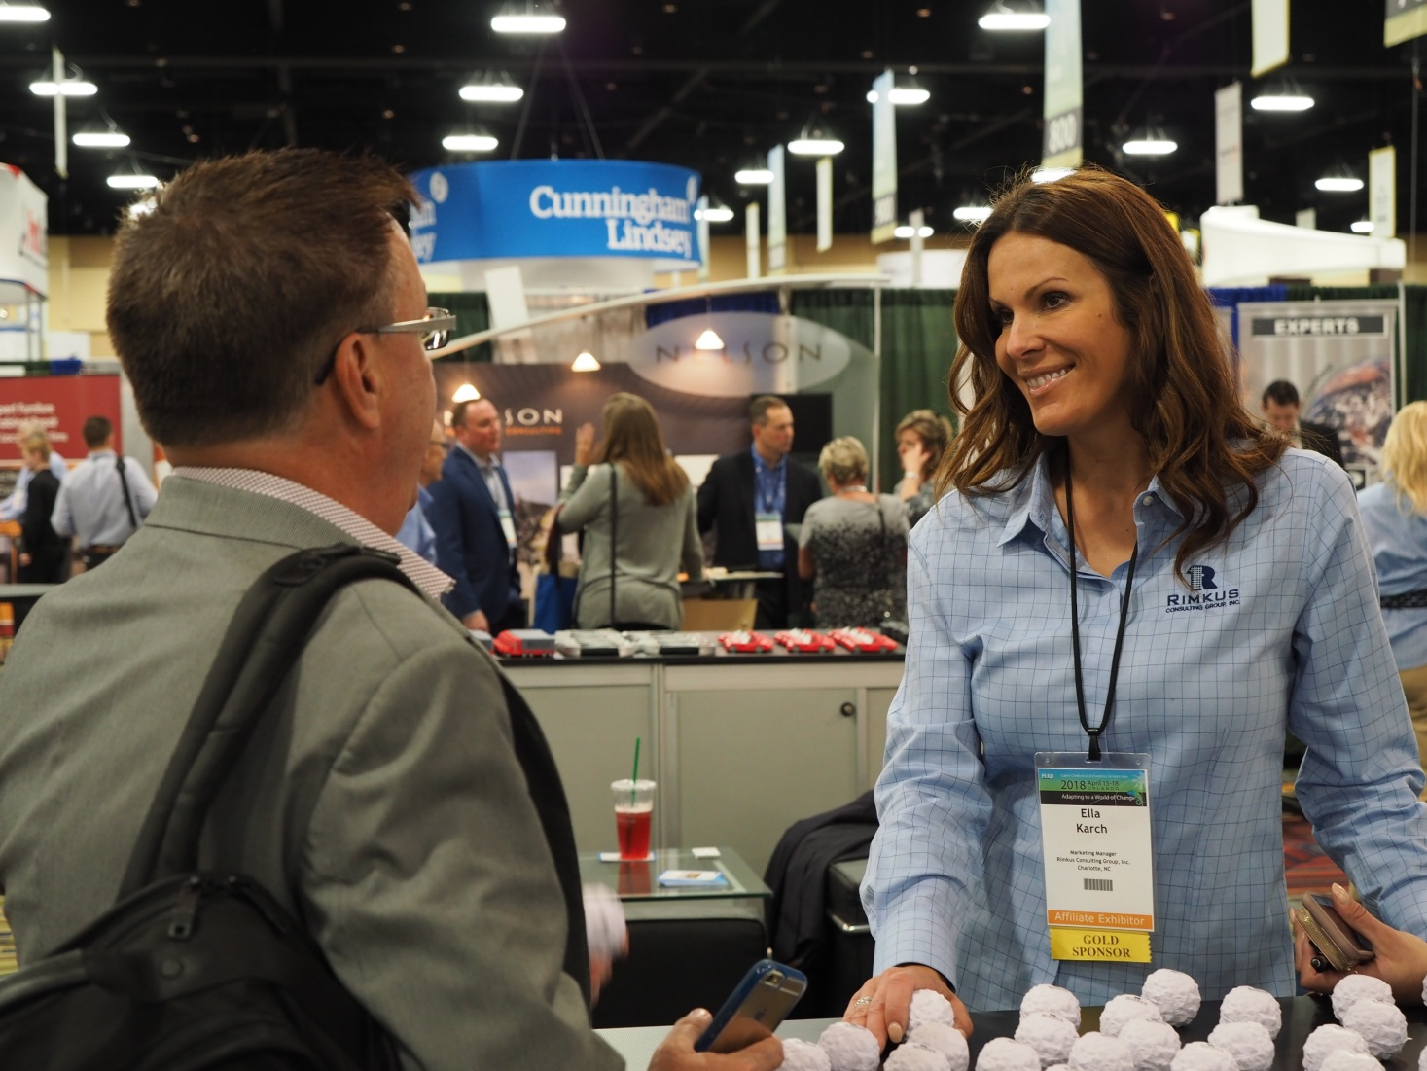

Slide 24

Download the PLRB Conferences Mobile App

Slide 25















Thank You Platinum Sponsors

Slide 26






























Thank You Gold Sponsors

Slide 27
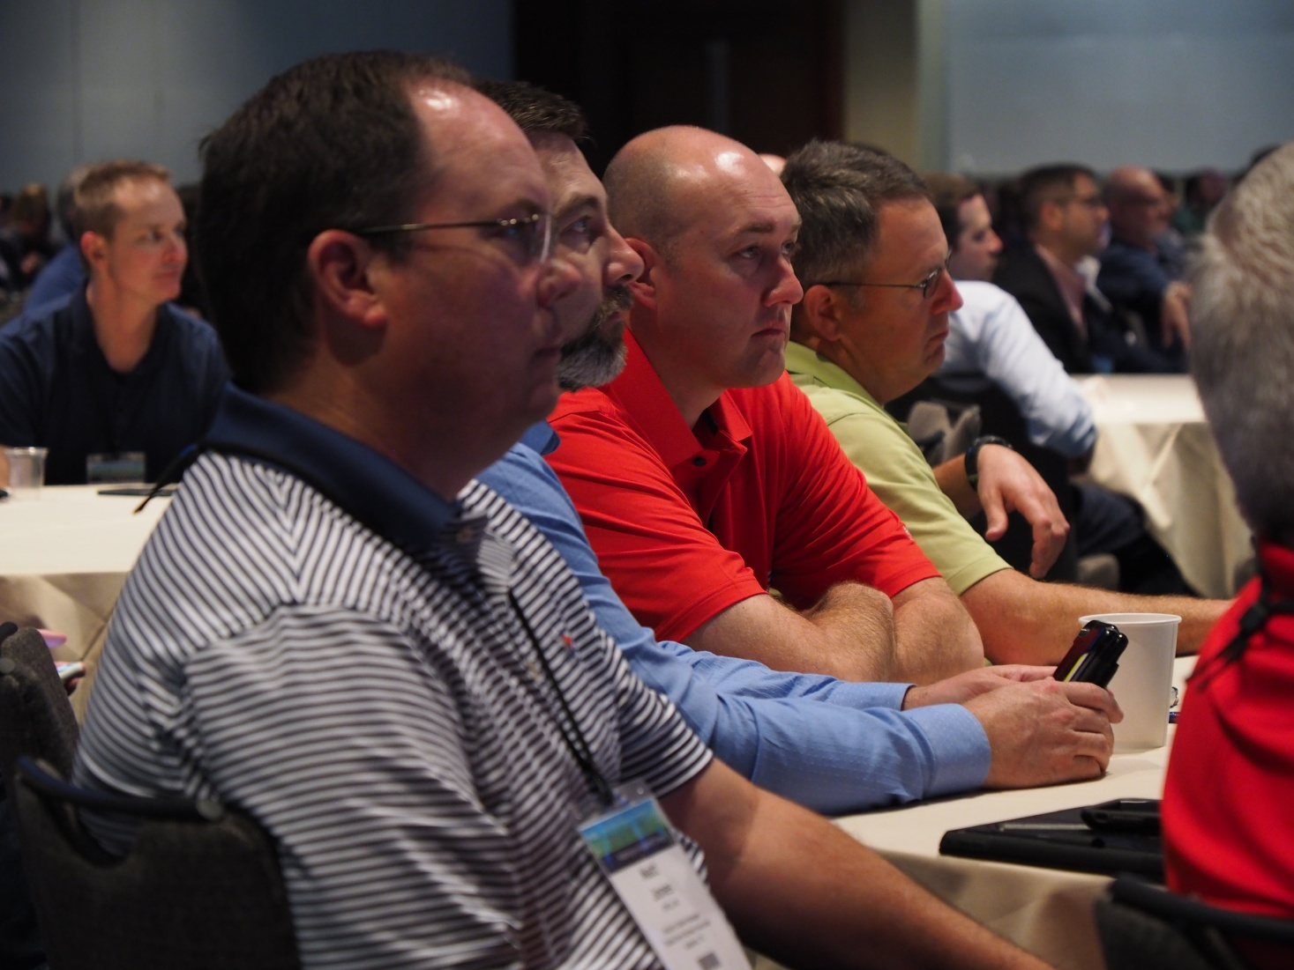
What is the dress code?
The dress code is business casual for all events.

Slide 28
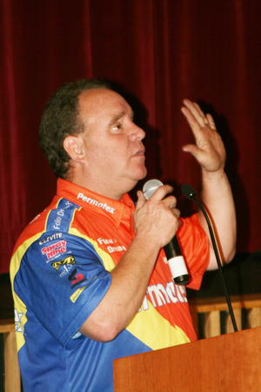
“The Five Tools For Your Life’s Toolbox”
Join us for Wednesday’s lunch presentation 12:00 p.m. – 1:30 p.m.
Sagamore Ballroom
Jay Blake President & Crew Chief, Follow a Dream

Slide 29

Educational Conferences
Look for a location near you…

Slide 30

New in 2019!

Slide 31
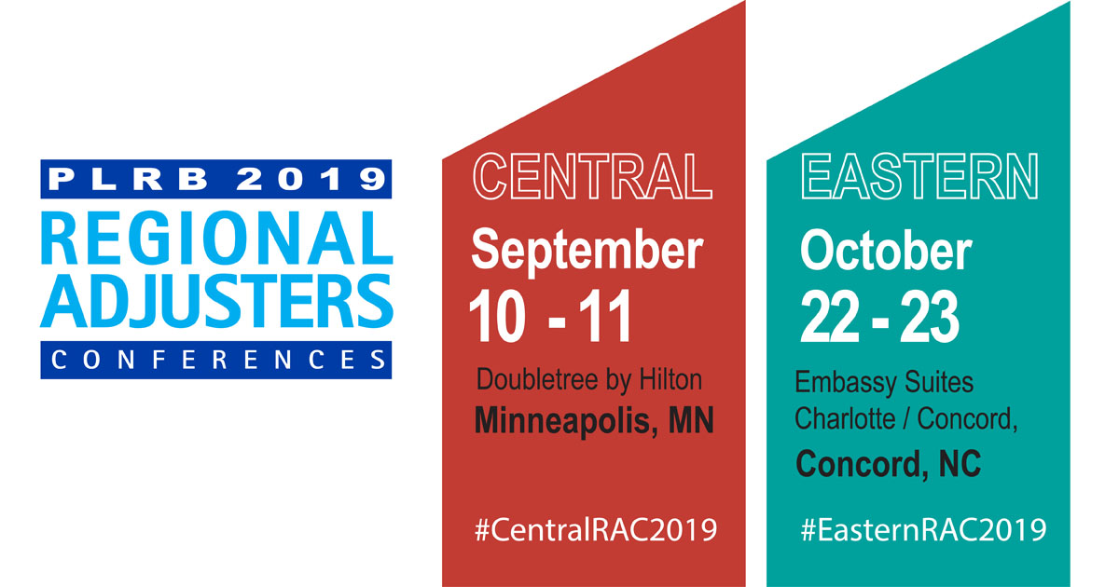

Slide 32
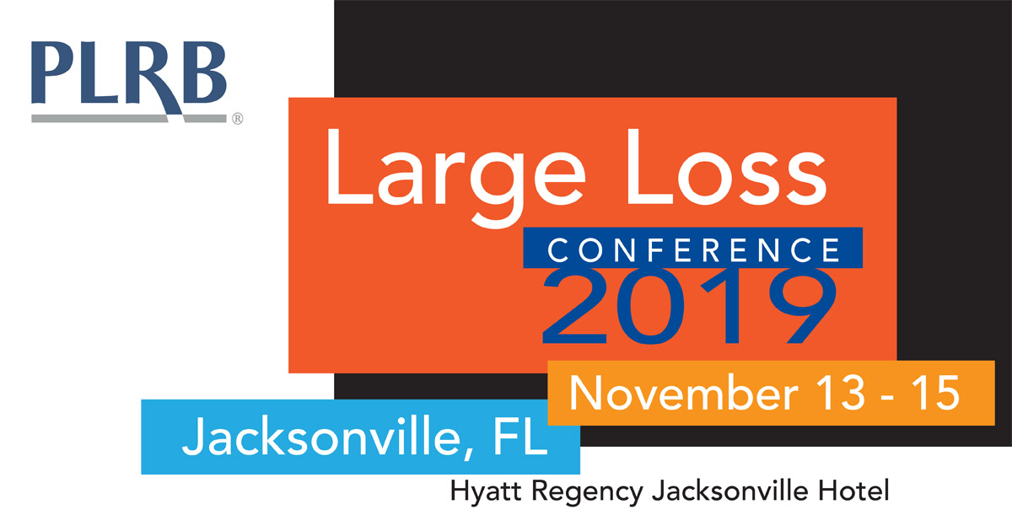

Slide 33
